Slide 1
Analytics Project Presentation - Summer 2015
Analytics Project:
Recommender Systems for NYC Residential Community
Team:
Zeleng Zhuang , Yanhong Yang, Nicholas Souris
Abstract:
Recommend communities suitable for a specific person based on personal preferences
Scrape data from various sources and use hadoop technology to cleanse and filter them
Build a website as a front-end to our system

Slide 2
Recommender Systems for NYC
Motivation
Who are the users of this analytic?
People who are looking to buy or rent an apartment in the wider New York city area.
Who will benefit from this analytic?
Prospective renters
Prospective buyers
Landlords
Sellers
Why is this analytic important?
It turns apartment hunting into a much less daunting task with the aid of an algorithm which automatically finds an area that is aligned to the users personal preferences.

Slide 3
Recommender Systems for NYC
Data Sources
Name: www.city-data.com
Description:
Several types of information indexed by zip code of the wider New York city area, such as race, religion, average income etc..
Name: bestplaces.net
Description:
Scraped data on crime rates for each zip code in New York city.

Slide 4
Recommender Systems for NYC
Data Sources
Name: yelp.com
Description:
Two different sets of data were scraped. One set involved information on clinics and kinder gardens and the other one had to do with restaurants and businesses in general.
Problem encountered:
Yelp would only present 1000 results per search which could possibly lead to limited accuracy of the recommendation system.
Solution:
Made searches by neighbourhood /area and concatenated the results. Redundant data was filtered using MapReduce.

Slide 5
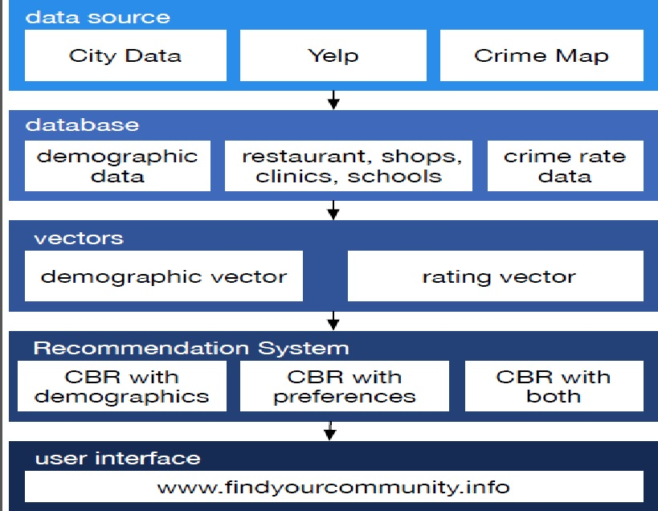
Recommender Systems for NYC

Slide 6
Recommender Systems for NYC
Data source level
Transportation and Crime data score calculation:
Found the minimum average of the two types of crime data. Added both types of crime data for each zip code and divided them by the minimum average.
For the rest of the data:
Waited averages were used.

Slide 7
Recommender Systems for NYC
Platform(s) on which the analytic ran:
Map-Reduce: Used to cleanse yelp data and calculate averages for scores.
Pig: Used to find maximum rating of hospitals.
Hive: Used to parse Map Reduce results in order to find minimum averages.
Spark: Used to find the minimum average time to reach workplace per zip code

Slide 8
Recommender Systems for NYC
Vector explanation:
Vectors are saved in a database and there are two versions.
Demographic vector: Keeps all the data scraped along with their scores. Each set is indexed by zip code
Rating vector:Keeps the users preferences.

Slide 9
Recommender Systems for NYC
Versions of recommendation.
Three versions are used in the website:
1) First version:
Used scraped data only.
2) Second version:
Uses first result along with users preferences.
3) Third version:
Uses user preferences only.

Slide 10
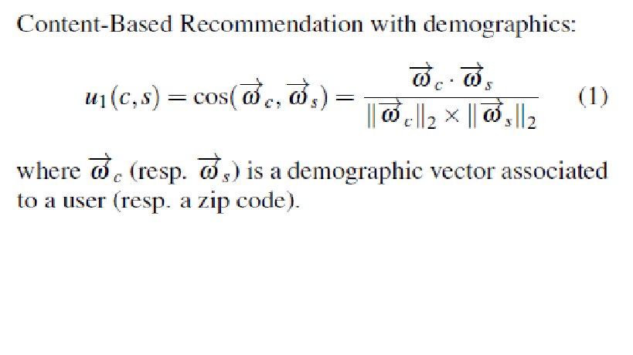
Recommender Systems for NYC
Results
1.
Score: Calculates cummulative score of a zipcode using user preferences.
C: customer
S: item

Slide 11
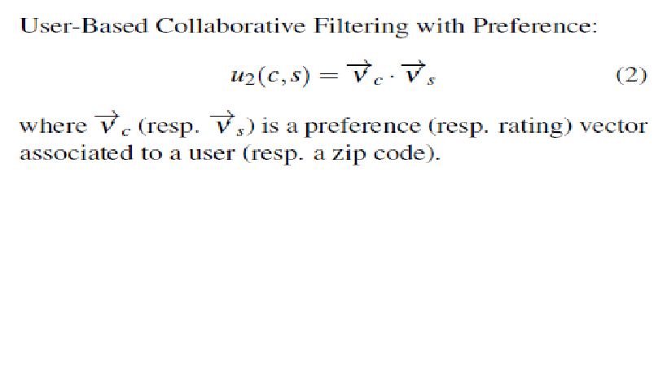
Recommender Systems for NYC
Results
2.

Slide 12
Recommender Systems for NYC
Results
3. Table of user ratings
 | Satisfied | Not Satisfied | Satisfied Rate
1st recommendation | 5 | 4 | 0.556
2nd recommendation | 6 | 1 | 0.857
Mixed recommendation | 2 | 1 | 0.667

Slide 13
Recommender Systems for NYC
Obstacles
1. Trying to authenticate the validity of the recommendations of the system.
2. Not enough time to implement more features (specific apartment recommendations, make recommendations on other cities as well)

Slide 14
Recommender Systems for NYC
Future additions and changes
1. Make the recommender system more specific involving specific apartments and studios available for rent in the recommended zip code area.
2. Develop a more sophisticated recommendation algorithm.
3. Develop a third round of recommendations which take into account the precious two along with the users satisfaction rate.
4. Develop a log in subsystem for the website that saves past searches and preferences.

Slide 15
Recommender Systems for NYC
Summary
Scraped data that had to do with New York city population and businesses.
Built a program that uses a vector based formula to recommend suitable areas to live in based on a users preferences.
Acknowledgements
Amazon Web Services
Cloudera

Slide 16
Recommender Systems for NYC
References
G. ADOMAVICIUS AND A.TUZHILIN.
Toward the Next Generation of Recommender Systems: A Survey of the State-of-the-Art and Possible Extensions.
IEEE Trans. Knowl. Data Eng. 17, 6 (June 2005)
2. R. BAEZA-YATES AND B. RIBEIRO-NETO.
Modern information Retrieval.
Addison-Wesley, 1999
3. J.S. BREESE, D. HECKERMAN AND C.KADIE.
Empirical Analysis of Predictive Algorithms for Collaborative Filtering.
In Proc. 14th Conf. Uncertainty in Artificial Intelligence, July 1998.
4. M. J. PAZZANI AND D. BILLSUS.
Content-based recommendation systems. IN P. Brusilovsky, A. Kobsa, and W. Nejdl (Eds.):
The adaptive web,
LNCS. 4321, pp. 325–341, 2007.

Slide 17
Recommender Systems for NYC
References
5. P. RESNICK, N. IAKOVOU, M. SUSHAK, P. BERGSTROM,AND J. RIEDL.
GroupLens: An Open Architecture for Collaborative Filtering of Netnews.
In Proc. Computer Supported Cooperative Work
Conf., 1994.
6. G. SALTON.
Automatic Text Processing.
Addison-Wesley, 1989.
7. U. SHARDANAND AND P. MAES.
Social Information Filtering:
Algorithms for Automating “Word of Mouth”.
In Proc. Conf. Human Factors in Computing Systems, 1995.
8. T. WHITE.
Hadoop: The Definitive Guide.
O'Reilly Media Inc.,
Sebastopol, CA, May 2012

